Slide 1
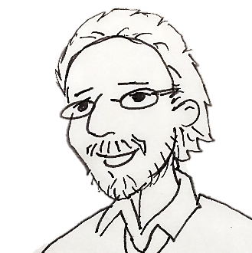
Dr. Shibblelove or
How I Learned to Stop Worrying and Implement Single-Sign On
LITA Forum | Minneapolis, MN | 12-15 November 2015
Athena Hoeppner Adam Traub
University of Central Florida University of Rochester

Slide 2
Login: A User’s Perspective
Researcher
Credentials
Canvas
Federated ID
User ID:
Password:
Login to Your Course
John
****
Shibboleth
Access

Slide 3
Authentication Part I
Hi Canvas. I’ll check his credentials.
Hey UCF shibboleth, check this guy for me.
Canvas
Federated ID
User ID:
Password:
Credentials
Answer This or you shall not pass!
Service
Provider

Slide 4
Authentication Part II
I know everything about him… Well, not as much as Google.
I can Authenticate him.
Do you know a guy with these Credentials
Hi UCF Identity Provider
Identity
Provider
Here is his NameID and some Assertions.
But I’ll only tell you what you are allowed to know.
LDAP
SAML
Security Assertion Markup Language https://www.samltool.com/generic_sso_res.php

Slide 5
Authorization
These Assertions tell you some of his Attributes
About that guy..
His NameId is Johnd,
An authenticated UCF eduPerson with PrimaryAffiliation Faculty
OK. Users with those Attributes are Authorized access for
And Faculty get extra permissions.

Slide 6
Login: A User’s Perspective
Here’s your page.
…and have a Cookie
He gets an IdP cookie, too.
UCF Canvas
Hello John D
Your courses: LIT321 Mythologies in Genre Fiction…
Notes:
I serve on the campus IT advisory group. One of the faculty on the committee reported wide-spread frustrations with using EZproxy.
They complained that they routinely log in to VPN, used links in emails and RSS feeds and on the open web,…

Slide 7
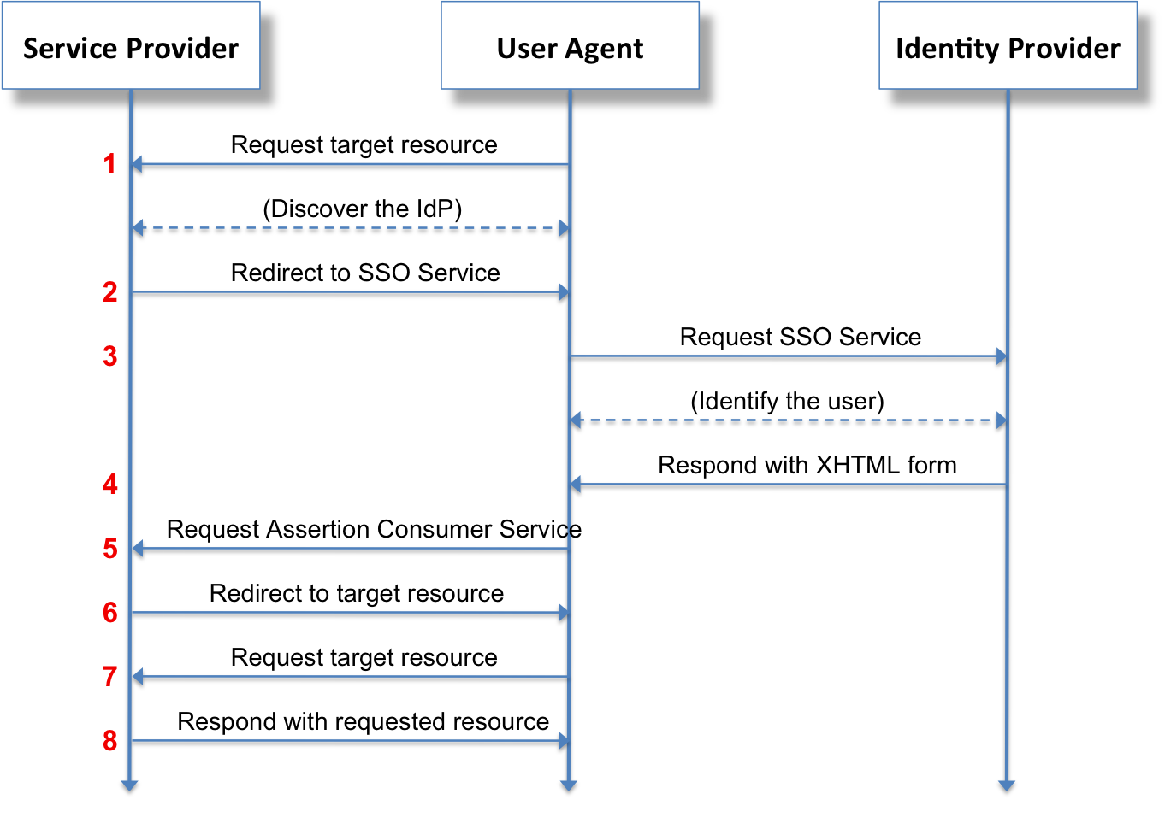
"Saml2-browser-sso-redirect-post". Licensed #/media/File:Saml2-browser-sso-redirect-post.pngunder CC BY-SA 3.0 via Wikipedia - https://en.wikipedia.org/wiki/File:Saml2-browser-sso-redirect-post.png

Slide 8
One Login; Many Services
UCF
Single Sign On (SSO)
Credentials

Slide 9
Federated ID
UCF
UR
Entity
Entity
ProQuest
EBSCO
Entity
Entity

Slide 10
Entity and Service Examples
UCF Canvas
UCF HR
Subscription Database
Service Providers (SPs)
UCF LDAP
UCF Active Directory
ID Providers (IdPs)
EntityIDs:
Unique Identifiers
https://auth.yale.edu/idp/shibb
http://qapub1.imodules.com/sp

Slide 11
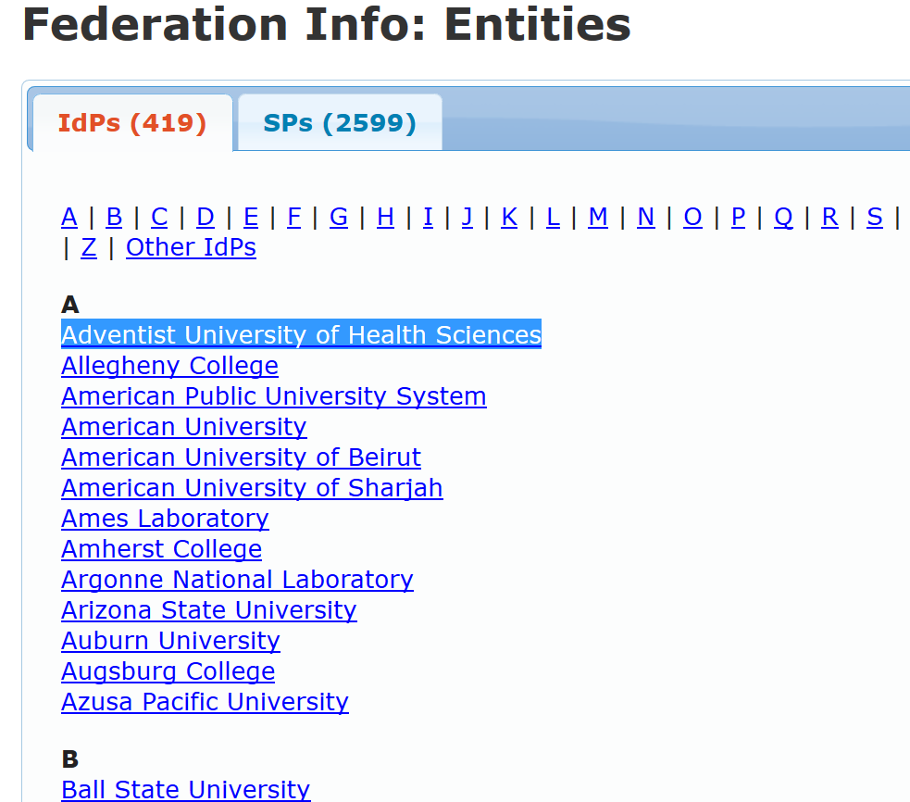
In theory, any of these SPs could authorize based on attributes from any of these IdPs

Slide 12
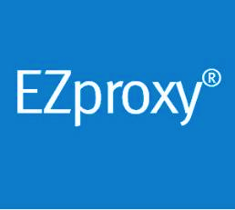
Tales of Three Shibboleth Service Providers

Slide 13
Lynda’s Tale
Previously logged in via IP
Couldn’t tell who was using it
Shibboleth already used for other campus services
Shibb login allows users to track progress
Notes:
Slide to show two various “business cases” for Shibboleth integration
Lynda
Reasons
Previously logged in via IP in “seat-model;” which went away and site-license required login regardless of location. (Think B24x7)
Anon: couldn’t tell who was using it, but the art folks were paying the bulk of the cost in cost-sharing (though we suspected use was widespread)
Other campus services (outside the library) were using Shibboleth (Course Management Software/Gmail)
Logged In: Know who is using it (generally reported in aggregate), allows users to track their own progress (as well as super-users tracking progress of “students” or staff)
Bonus
High Demand Resource; no longer anon users
Smoother login process (campus uses Shibb for mail and LMS)
Individuals can track and save their progress in long courses
Integration with course assignments (power users)

Slide 14
HathiTrust’s Tale
Membership requirements:
Academic and research Institution
Paid fee
Shibboleth for authentication
Benefits:
Complete PDF download
Access to in-copyright material if owned by university
Notes:
HathiTrust
Reasons
HathiTrust – not completely Open Access
Membership Requirements:
Academic and research institutions
Submission of information about print holdings.
$$ Fee
Shibboleth
102 partner institutions listed on the Community page - colleges, universities, and 3 consortia
Academic and research institutions.

Slide 15
Ezproxy’s Prologue
IP authentication widely used by vendors
Existed separately from campus federated ID and single sign on
Familiar to users
Extend campus single sign-on experience for database and journal access

Slide 16
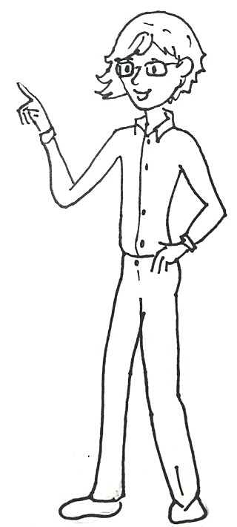
Relationship Building
Identity Management
Data!
Access!

Slide 17
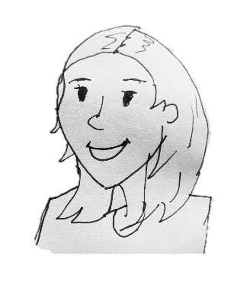
Functional Anecdote
E-Res Librarian
Role: Cheerleader; Project Manager; Requirements Co-Creator
Library IT
Role: Facilitator; Co-Creator; Internal Advisor
Central IT
Role: Shibboleth Admin; Attribute Mapper
Vendor IT
Role: Service Provider; External Advisor

Slide 18
Key Attributes
An attribute is simply a name-value pair providing single piece of information. Some subset of all attributes defines a unique individual.

Slide 19
Shibboleth and EduPerson
“Shibboleth is a standards based, open source software package for web single sign-on across or within organizational boundaries.”
I have one of each of those attributes!
EduPerson Schema
Supports LDAP Environments
Familiar Attributes
CommonName
Surname/Family Name
Email
UserID
Notes:
Examples taken from eduPersonAffiliation controlled vocabulary (aka “permissable values”): https://www.internet2.edu/media/medialibrary/2013/09/04/internet2-mace-dir-eduperson-201203.html#eduPersonAffiliation
If Shibboleth is the software that allows single-sign on from Blackboard to EZProxy, EduPerson is the schema that allows that ability to be applied outside the institution so you can go directly from Blackboard to a library database

Slide 20
EduPerson Schema - Affiliations
eduPersonAffiliation
“broad category affiliations”
Examples:
Faculty
Staff
Student
Alum
Employee
Member
Affiliate
Library-Walk-in
I graduated from this place AND I work here as Faculty!
Notes:
Examples taken from eduPersonAffiliation controlled vocabulary (aka “permissable values”): https://www.internet2.edu/media/medialibrary/2013/09/04/internet2-mace-dir-eduperson-201203.html#eduPersonAffiliation

Slide 21
EduPerson Schema - Affiliations
eduPersonPrimaryAffiliation
“Think of this as the affiliation one might put on the name tag if this person were to attend a general institutional social gathering.”
Must also appear in eduPersonAffiliation
Faculty
(mostly)

Slide 22
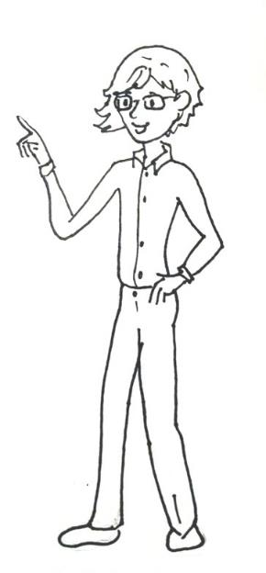
EduPerson Schema - Affiliations
eduPersonScopedAffiliation
“Specifies the person's affiliation within a particular security domain in broad categories.”
HathiTrust requires Scoped Affiliation
Example:
What is Athena’s affiliation to UCF, as translated by HathiTrust?
faculty@ucf.edu
Scoped Affiliation
Notes:
In this example, if two institutions had identical licenses that allowed access for faculty, but not staff, it might play out like this:
At UCF, Athena is considered faculty; so her “ScopedAffiliation” in regards to HathiTrust should be “faculty,” authorize Athena to use HathiTrust
At UR, Adam is considered staff; so his “ScopedAffilition” in regards to HathiTrust should be “staff,” not authorize Adam To use HathiTrust (block access)

Slide 23
Gollum the Freshman
3
1
I need you to login.
Precious wants your database.
4
UN Precious;
PW: Precious
6
Ugh. Here you go, Gollum.
5
That’s Gollum; he’s a student.
2
LDAP
Do you know this person?
Notes:
Diagram template adapted from UFL: http://identity.it.ufl.edu/technical/shibboleth-docs/data-flow/

Slide 24
Frodo the Alumnus
3
1
I need you to login.
I’d like to use your database.
4
UN Fbaggins;
PW: i<3Sam
6
Your license doesn’t allow alum access.
5
That’s Frodo; he’s an alum.
2
LDAP
Do you know this person?
Notes:
Diagram template adapted from UFL: http://identity.it.ufl.edu/technical/shibboleth-docs/data-flow/

Slide 25
Saurman the Forgetful (or Malicious)
3
I need you to login.
1
I’d like to use your database.
4
UN: SauronRules;
PW: friend?
6
Not with that attitude (or login) you won’t.
5
I have no idea who this is
2
LDAP
Do you know this person?
Notes:
Diagram template adapted from UFL: http://identity.it.ufl.edu/technical/shibboleth-docs/data-flow/

Slide 26
WAYFless URL Authentication
Login as per usual…
WAYFless URL
IdP already identified
LDAP
Notes:
Diagram template adapted from UFL: http://identity.it.ufl.edu/technical/shibboleth-docs/data-flow/

Slide 27
Wraithless URLs
X WAYFless

Slide 28
Chocolate and red wine–A comparison between flavonoids content
FA Pimentel, JA Nitzke, CB Klipel, EV de Jong - Food chemistry, 2010 - Elsevier
Whoa!! This article is perfect!
... Cocoa has also been described as being a good source of flavonoids, such as catechins. ... Based on this, the present study was carried out to compare flavonoids content of different types of red wine and chocolate and to suggest a daily chocolate ingestion dose that could ...

Slide 29
You are a Guest. Sign In
Chocolate and red wine–A comparison between flavonoids content
FA Pimentel, JA Nitzke, CB Klipel, EV de Jong - Food chemistry, 2010 - Elsevier
Oh No… I don’t have an Elsevier Login!
But the Mordor University Library should have this…

Slide 30
Where Are You From?
I don’t even know where to begin checking his credentials. Better make small talk…
So… where are you from?

Slide 31
Where Are You From
Choose your region or group and institution below to login.
Region or Federation:
Institution:
Mordor
Nazgul Group
This should get me access.

Slide 32
WAYF Authentication
1
I demand the article on chocolate and wine!
5
2
Where Are You From?
login.
6
3
I’m with the Nazgul!
UN: NazgulKing;
PW: Immort@l
8
OK. Read up!
SAURAN
LDAP
7
That’s NazgulKing; he’s Sauran’s Liutenant.
4
Do you know this person?
Notes:
Diagram template adapted from UFL: http://identity.it.ufl.edu/technical/shibboleth-docs/data-flow/

Slide 33
Access to Everything Else…

Slide 34
Ezproxy as a Shibboleth Service Provider
Notes:
Most publishers and database vendors are not members of InCommon Federation
Ergo, they don’t have EntityIDs and can’t be SPs.
IP authentication widely used
What’s an eResouces Librarian to do?
Shibbolize Ezproxy!

Slide 35
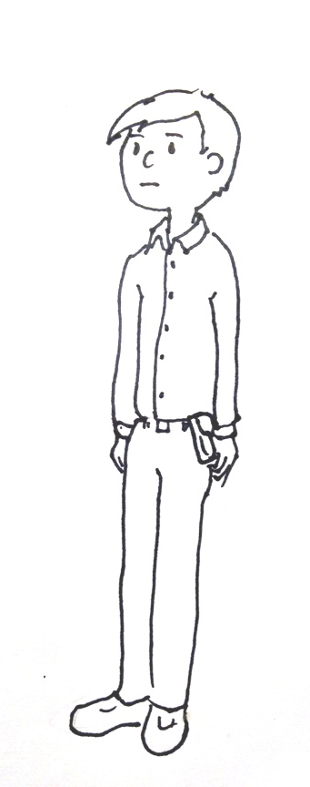
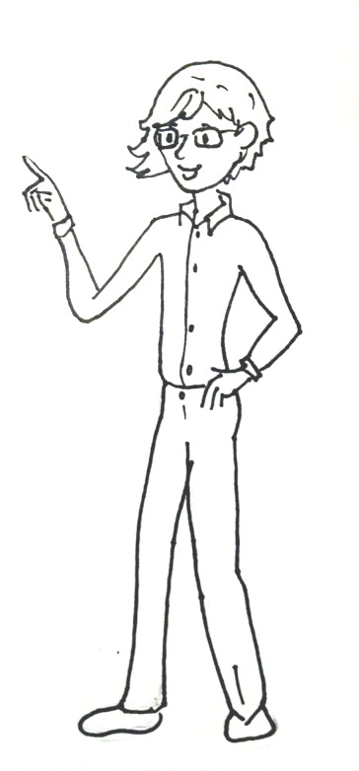
Library Vendors in InCommon Federation:
Hathi Trust
EBSCOhost
ProQuest
EBL
Elsevier
JSTOR
…and many more
https://spaces.internet2.edu/display/inclibrary/targetresources https://spaces.internet2.edu/display/inclibrary/registryofresources
OK
Enable Please!!
They get our ENTITYid, and the eduPERSON assertation.

Slide 36
InCommon Best Practices for Libraries
Implement authorization via eduPerson attributes
Shibboleth enable EZproxy
Implement WAYFless URLs
Implement authenticated direct links to resources.
Use Shibboleth-Ready Ezproxy Starting point URLs
https://spaces.internet2.edu/display/inclibrary/Best+Practices
Notes:
There are great guides on Internet2.
Register EZproxy as a SP Entity on your campus
Set up attributes will be released to EZproxy
Identify the roles that are authorized to use the service
Add code to EZproxy config
Modify startingpoint URLs
I chose not to implement WAYFless URLs. They would be similar to EZproxy starting point URLs. They would bypass the WAYF menus.
From my perspective, they do not eliminate the need to maintain EZproxy configurations.
Many library vendors do not participate in the InCommon Federation.
Links from the Shibb authorized site would not necessarily go to shibb sites, so authentication would drop.

Slide 37
EZproxy config.txt
#### Shibboleth Stuff
ShibbolethDisable 1.3
ShibbolethMetadata \
-EntityID=LibraryEZProxy \
-File=ucf-prod-metadata.xml \
-Cert=4 \C
-URL=https://idp-prod.cc.ucf.edu/idp/shibboleth
SP Entity name!
UCF’s IdP Entity!

Slide 38
Shibuser.txt
EZproxy Admins
if auth:urn:oid:1.3.6.1.4.1.5923.1.1.1.6 eq "LibITGuy@ucf.edu";
Admin
Deny Access to Problem Users
if auth:urn:oid:1.3.6.1.4.1.5923.1.1.1.6 eq “BadUser@ucf.edu";
Deny
Set EZproxy username to UCF ID
set login:loguser = urn:oid:1.3.6.1.4.1.5923.1.1.1.6

Slide 39
Attribute Summary Table
Friendly Name | Formal Names
eduPersonScopedAffiliation | urn:oid:1.3.6.1.4.1.5923.1.1.1.9
eduPersonPrincipalName | urn:oid:1.3.6.1.4.1.5923.1.1.1.6
eduPersonEntitlement | urn:oid:1.3.6.1.4.1.5923.1.1.1.7
eduPersonTargetedID | urn:oid:1.3.6.1.4.1.5923.1.1.1.10
sn | urn:oid:2.5.4.4
givenName | urn:oid:2.5.4.42
displayName | urn:oid:2.16.840.1.113730.3.1.241
mail | urn:oid:0.9.2342.19200300.100.1.3
InCommon Federation Attribute Summary https://www.incommon.org/federation/attributesummary.html

Slide 40
Shibuser.txt Revisited
if eduPersonPrincipalName equals thisperson then give them admin rights
if auth:urn:oid:1.3.6.1.4.1.5923.1.1.1.6 eq "LibITGuy@ucf.edu";
Admin
if auth:urn:oid:1.3.6.1.4.1.5923.1.1.1.6 eq “BadUser@ucf.edu";
Deny
set login:loguser = urn:oid:1.3.6.1.4.1.5923.1.1.1.6
if eduPersonPrincipalName equals thisperson then deny them access
Set login to user’s eduPersonPrincipalName

Slide 41
EZproxy Shibb URLs
EZproxy Starting Point URLs https://login.ezproxy.net.ucf.edu/login&url=
Shibbolized https://login.ezproxy.net.ucf.edu/login?auth=shibb&url=
UCF Deployed in:
SFX
EBSCOhost Discovery
LibGuides and Database list

Slide 42
Too Permissive!
Everyone I know is an EduPerson!
That’s good enough for me.
Current students
Faculty
Employees
Alumni
Previous students
Department network accounts…
YIKES!!!
LDAP
EZproxy

Slide 43
Common Library Entitlements
Based on this doc, Implementing the Shibboleth - EZproxy Hybrid - InCommon, I think we need to add this to our shibuser.txt:
If !(auth:urn:mace:dir:attribute-def:eduPersonEntitlement eq
"urn:mace:dir:entitlement:common-lib-terms"); Deny
I assume that our IdP is set up with the standard common-lib-terms entitlements. If not, then we should ask Matt and his crew to add it.

Slide 44
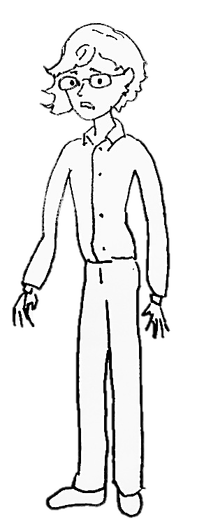
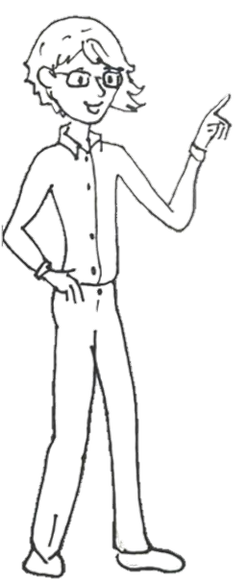
common-lib-terms
Nope
The common-lib-terms entitlement value represents the members
of an institution that are
included in the terms of
typical library contract
with a library
resource provider.

Slide 45
Getting EZProxy Out of the Way
Challenges
Out-dated EZProxy links
Leverage service provider Shibb support
SPUEdit
“Rarely used directive”
Best Practice
Here…let me fix that for you…
https://www.incommon.org/library/docs/Best_Practices.pdf
Notes:
https://www.incommon.org/library/docs/Best_Practices.pdf
Shib/EZProxy Hybrid compliance

Slide 46
Summary
Shibboleth enables
Single sign on across institution and federation services
Seamless user experience
Customized services based on attributes,
Personalized services for individuals,
Anonymity
Requires collaboration:
Campus IT
Library IT
eResources Librarians
Works with and expands on Ezproxy, IP-based, authentication
Shibb!
Shibb!
Shibb!
Shibb!
Shibb!
Shibb!
Shibb!
Shibb!
Shibb!
Shibb!
Notes:
Why Libraries (why not just campus IT?)
Understand who should have access and who should NOT have access
Know vendors who can be SPs
Imagine nifty things that shibboleth could do for us

Slide 47
Additional Resources
Implementation Info
Vendor Specific Info
InCommon Library Collaboration
Registry of Resources
Shibb Training
Shibb – EzProxy Hybrid
EZProxy
EBSCO
ProQuest
JSTOR
ACM
Elsevier
Ovid
Project Muse
Thomson

Slide 48
Glossary
Assertion - The identity information provided by an Identity Provider to a Service Provider.
Attribute - A single piece of information. Some attributes are general; others are personal. Some subset of all attributes defines a unique individual. Examples of an attribute are name and enrollment.
Attribute statement: asserts that a subject is associated with certain attributes. An attribute is simply a name-value pair. Relying parties use attributes to make access-control decisions.
Authentication statements: statement that the principal did indeed authenticate with the identity provider at a particular time using a particular method of authentication.
Authorization decision statement: asserts that a subject is permitted to perform action A on resource R given evidence E.
eduPerson - An LDAP object class to facilitate inter-institutional applications
Provider url, and the network administrator.
EntityID - ID that identifies an enterprise in a federation. Usually a URL that points to an XML file of info about the entity, such as the ID
Federated identity - management of identity information between members of a federation.
Identity Provider (IDp) - The system that authenticates an entity
Security Assertion Markup Language (SAML, pronounced sam-el) is an XML-based, open-standard data format for exchanging authentication and authorization data between parties, in particular, between an identity provider and a service provider. (Wikipedia)
Service Provider (Sp) - makes online resources available to users based in part on information about them that it receives from other InCommon participants.
Where Are You From (WAYF) - A server used by the Shibboleth software to determine what a user's home organization is.
http://en.wikipedia.org/wiki/Security_Assertion_Markup_Language#SAML_Assertions

Slide 49
Questions?

Slide 50
Thank you!
Athena Hoeppner, UCF
Adam Traub, UR

